Slide 1
ML in Telecommunications: Building Intelligent Systems with Machine Learning
Name: Christ-Brian Amedjonekou
Date: 05/22/2019
TCET 3102-E316 (Analog and Digital Communications) Final Report: ML in Telecommunications
Spring 2019, Section: E316, Code: 37251
Instructor: Song Tang

Slide 2
Objectives
Brief history/background of Machine Learning
Explain how it’s used in the Telecom industry
Describe the characteristics/features of Machine Learning
Describe possible improvements/growth it can undergo in Telecom

Slide 3
What is Machine Learning/What is the Goal?
One technical definition includes the following:
  Machine learning is the scientific study of algorithms and statistical models that computer systems use to effectively perform a specific task without using explicit instructions, relying on patterns and inference instead.
The goal of Machine Learning is to be predictive (some, usually business folk, refer to machine learning as being predictive analytics).

Slide 4
Features of ML?
Borrowed Mathematical Modeling techniques including, but not limited to, Mathematical Optimization which is the selection of a best element (with regard to some criterion) from some set of available alternatives.
The main difference in approach between more traditional Mathematical Modeling paradigms and Machine Learning is the fact that Machine Learning very Data Driven as opposed to being Analytical Driven.

Slide 5
History of Machine Learning?
It is simply the combination of math known for centuries plus the advancements in computing over the past 70 years that form the foundation of what we know Machine Learning to be today.
Bayes Theorem, a theorem developed by Thomas Bayes in the 18th century about conditional probability, is foundational to Machine Learning; A Machine Learning model call Naïve Bayes Classifier trains Supervised Models using Bayes Theorem.
Regression, another important method used in Machine Learning, uses the Least Square Method for data fitting which was developed by Adrien-Marie Legendre. Finally, Markov Chains, developed by Andrey Markov and used in Stochastic (Probabilistic) Modeling, is also a major contributing factor towards the development of Machine Learning.

Slide 6
History of Machine Learning?
In the 1940s stored-program computers that could hold their instructions (programs) in the same memory used for data had made significant progress.
In 1950, Alan Turing, considered by most to be the godfather of theoretical computer science, published Computer Machinery and Intelligence where he posed the following question: “Can machines think?”.
  Proposed an imitation game. The goal of the game was to determine whether a computer was intelligent. This was done by asking a person to distinguish between a human and a computer when communicating with them both through typed messages.

Slide 7
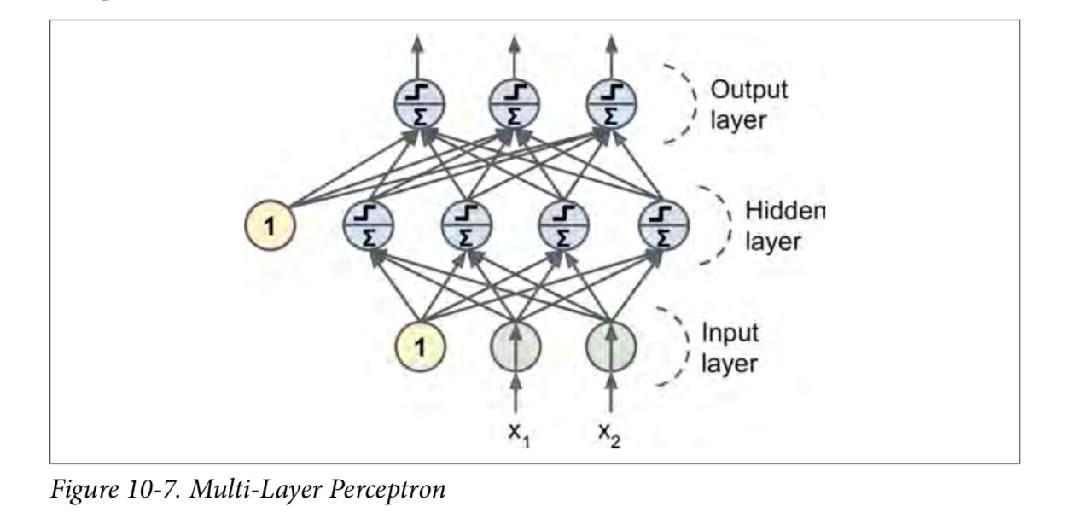
History of Machine Learning?
1951, Marvin Minsky and Dean Edmonds built the first artificial neural network. An Artificial Neural Network, abbreviated ANN, is our take on another powerful computing device, our brains.

Slide 8
History of Machine Learning?
AI winter in the 60s - 90s
Deep Mind in 1996 defeats chess champion Garry Kasparov
  Accomplish this in part because it relied on brute computing power. Deep Blue worked by searching 6 to 20 moves ahead at each position, having learned by evaluating thousands of old chess games to determine the path to checkmate.
2000s and above?
  AlphaGo and Deep Mind
    It uses a Monte Carlo tree search algorithm to find moves.

Slide 9
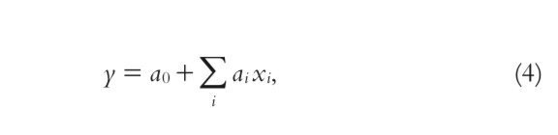
Applications of Machine Learning in Telecom
Most of it involves human interaction ranging from conducting drive tests in order to evaluate the network coverage and performance to diagnosing customer complaints.
Linear Regression
  approximating well the Shannon capacity formula which tells the maximum rate at which information can be transmitted over a communications channel of a specified bandwidth in the presence of noise.

Slide 10
Applications of Machine Learning in Telecom
The coefficients are determined by minimizing the root mean squared error (RMSE) of the predictor. ‘y’ becomes simply the best approximation of the network throughput as the optimal weighted sum of the individual Shannon capacity estimates. As a result, linear regression can be used as an improved proxy for simple SINR-based user data rate models relying on Shannon capacity formula.
Markov Chains
  Another potential problem where Machine Learning can be useful is in addressing the issue of HO prediction in mobile networks. A handover is a process in telecommunications and mobile communications in which a connected cellular call or a data session is transferred from one cell site (base station) to another without disconnecting the session. Modeling Mobility behavior of the users with Renewal Markov Renewal Process (MRP) to predict both the single and multi-transition.
  hybrid Markov-based models can be used for human mobility predictions

Slide 11
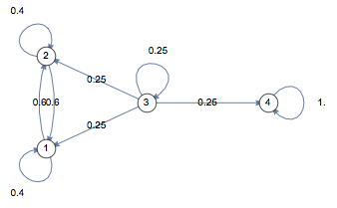
Applications of Machine Learning in Telecom

Slide 12
Applications of Machine Learning in Telecom
Artificial Neural Networks
  Artificial Neural Networks can be used to learn the user patterns to use them for future location predictions in UMTS networks, decreasing the location update signaling overhead.

Slide 13
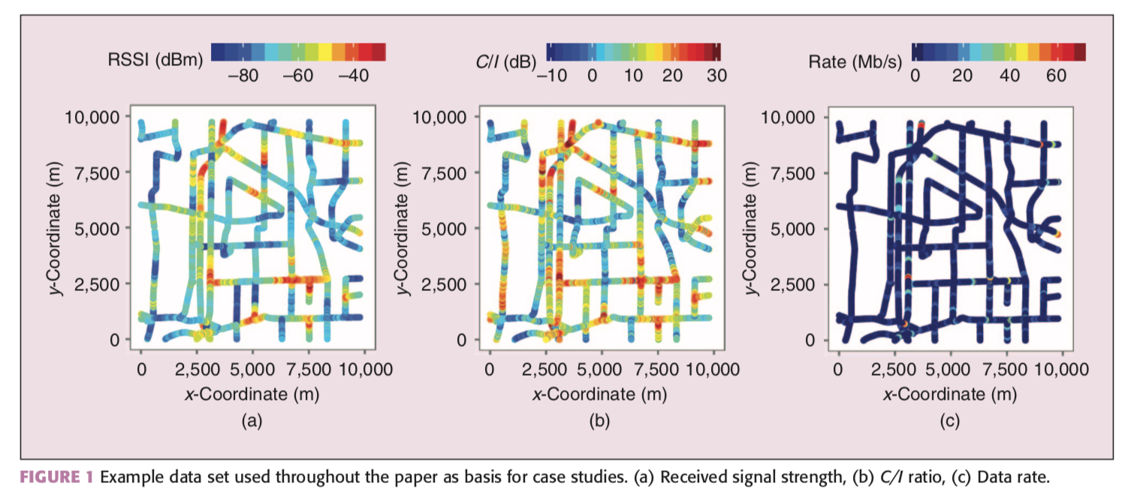
Machine Learning Process
First you would examine your data and determine if cleaning is necessary to get it in the proper form to implement the model
Then you would visualize your data in some form of plot (as shown above) to see if you can determine what model would fit best to the problem.
Then you would split your data into two sets: a test set, and a training set. The training set is used to train the model as the name suggest. The test set is used to see if the model selected performs well on new data.

Slide 14
No Title Needed – This is the END.
END

